Slide 1
IoT Monitoring Dashboard Capstone Project — Milestone Progress Update
Program BAS Application Development
Course CSI-492 Senior Capstone Project
Student Quoc Bao Tran Date 5/31

Slide 2
Schedule Update Status: On track
Project Progress Update
Time Period | Dates |  | Focus |  | Status/Progress Update
Week 1–2 | 4/6 – 4/19 |  | Planning — project charter, requirements, architecture |  | Project charter approved; requirements documented; architecture defined (MQTT → API → SQL → SignalR → React).
Week 3–4 | 4/20 – 5/3 |  | Data — SQL Server schema, EF Core entities, migrations, seed/test data |  | SQL schema designed; EF Core entities & migrations applied; seed/test data loaded.
Week 5–6 | 5/4 – 5/17 |  | Backend — repositories, services, REST API, MQTT ingest, command dispatch, SignalR, alerts. |  | Repositories & services implemented; REST API live; MQTT ingest & command dispatch working; SignalR hub & alert evaluation connected.
Week 7–8 | 5/18 – 5/31 |  | Frontend — React dashboard, auth, live charts, devices, commands, alerts UI |  | React dashboard built; JWT auth integrated; live charts via SignalR; device, command, and alert pages functional.
Week 9–10 | 6/1 – 6/14 |  | Integration & testing — Arduino ↔ Mosquitto ↔ API ↔ SQL ↔ SignalR ↔ UI (end-to-end)
Week 11 | 6/15 – 6/19 |  | Documentation & presentation — final docs, polish, demo prep → Final presentation 6/17

Slide 3
Milestone summary
Goal: Build the React web dashboard so operators can log in, monitor live sensor data, manage devices, send commands, and view alerts.
Status: Complete
Completed work:
Built React + TypeScript SPA with routing and navigation (Dashboard, Devices, Sensors, Actuators, etc.)
Implemented JWT authentication — login page, protected routes, admin-only user management
Connected SignalR for live updates (SensorReadingReceived) on device detail charts
Added live charts with Recharts — analog gauges, discrete indicators, SCADA-style live window (2s–30m)
Completed device UI — device list, add/edit, device detail with sensors and actuators
Completed commands UI — send commands from device page; command history page
Completed alerts UI — alerts list and alert rules configuration page
Integrated all pages with REST API (devices, sensors, readings, commands, alerts)
Progress (schedule table): React dashboard built; JWT auth integrated; live charts via SignalR; device, command, and alert UI functional.

Slide 4
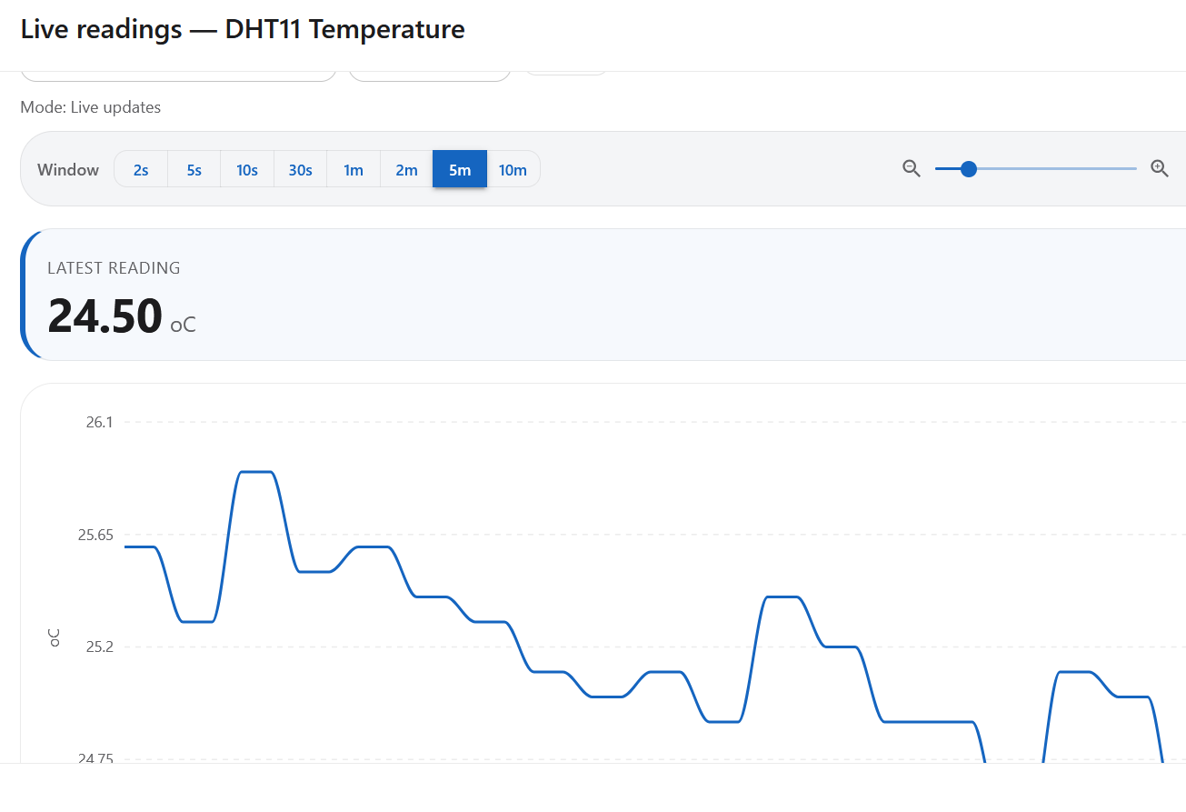
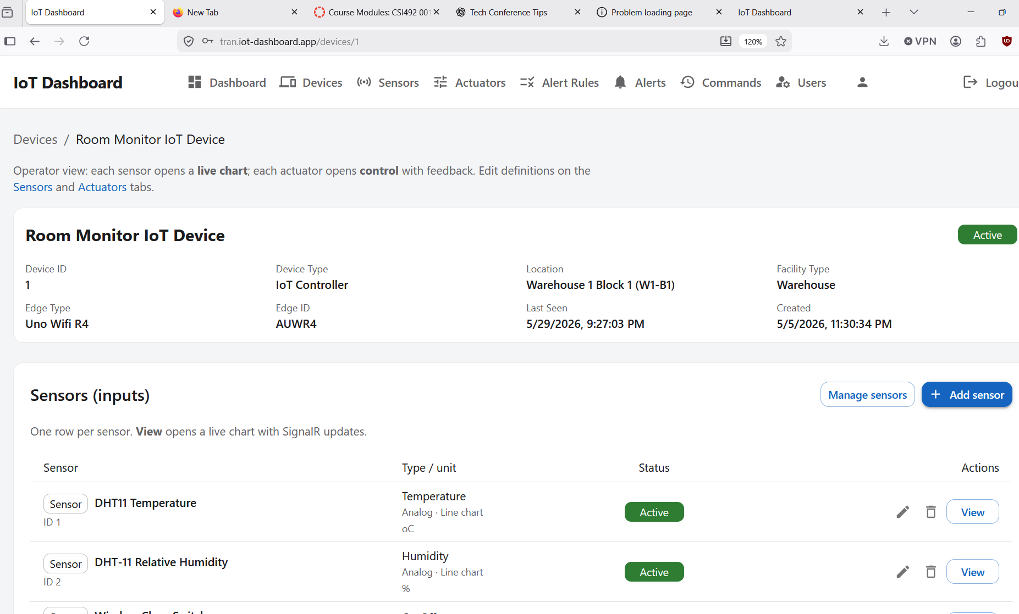
Evidence / screenshots
Fig. 1 — Design / UI
Fig. 2 — Live monitoring

Slide 5
Problems & solutions
Live chart showed latest value but no line | Fixed time-window trim and SignalR handler in DeviceTemperatureChart
Chart empty or stale when switching Live ↔ History | Cleared/refetched chart data on mode switch; aligned live window with Date.now()
SignalR not receiving updates after login | Passed JWT to hub connection; subscribed to correct device/sensor on device detail page

Slide 6
Barriers
No other critical blockers at this milestone.

Slide 7
Reflection & next steps
Learned: Real-time UI needs SignalR and chart time-window logic designed together; TypeScript types must match API DTOs.
Next (Week 9–10): End-to-end integration & testing — Arduino ↔ Mosquitto ↔ API ↔ SQL ↔ SignalR ↔ UI.

